Slide 1
Monday, 06 June 2022
Science Fair Lesson 5: Carrying out investigations
Expected learning outcome for today:
To draw a table of results (with pencil and ruler) to record investigation results and understand why repeats should be included.
Today’s key vocabulary:
Average (or mean) – Add up the numbers and divide by how many there are
Unit – the measurement used on a scale
Starter:
How do you draw a table of results? What should be included?

Slide 2
Starter
Look at the examples of tables that you have been given on the sheet.
Discuss:
What do all tables have in common?
Why are tables not all the same?
What basic rules should be followed when preparing a table of results?
Extension – write your rules on sticky notes to share as a class.

Slide 3
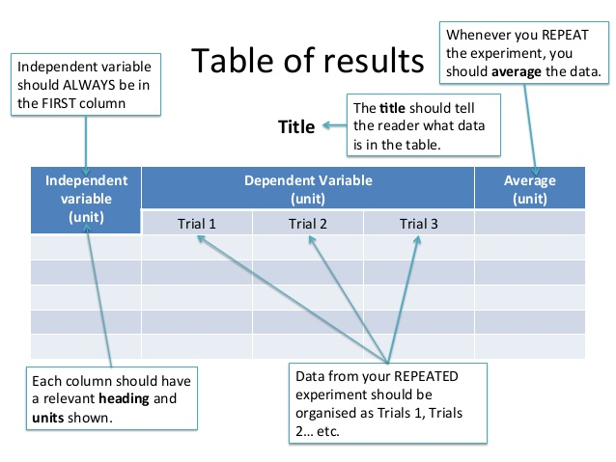
Common errors:
Forgetting units
Not leaving enough space to fit all of the columns in
Not leaving space for the trials (or repeats) on the right

Slide 4
Main Task 1 – Drawing a table
You are going to draw a table of results for your investigation.
You should always use a pencil and ruler to draw the lines.
Make sure you include the unit in the table heading (if there is one) and then do not repeat it in the results you record as there is no need.
Draw your table so that it fits nearly on your paper (or you may be able to use a computer to make a table).
Make sure you have labelled each column and included correct units where they are needed.
Include a suitable title for your table that it explains what the table is showing.
Extension – can you remember (or do you know) how to work out the average result?

Slide 5
Main Task 2 Averages
A table showing the temperature of milk chocolate as it is heated in a pan
Time (seconds) | Temperature of chocolate as it is heated (ºC)
 | Trial 1 | Trial 2 | Trial 3 | Average
0 | 19 | 19 | 19
60 | 21 | 23 | 22
120 | 27 | 28 | 28
180 | 35 | 26 | 35
240 | 44 | 47 | 48
19
22
27.7*
32 or 35**
46.3*
*We normally round to the same places as the results we gathered so 28 and 46 would be okay.
Work out the average for each result (remember to use BIDMAS)
**Look at the result for 180 seconds, trial 2. What should we do differently here?
Summarise why we carry out repeats in a sentence.
Notes:
Anomalies should be discounted or re-tested.

Slide 6
Plenary
Q. What should go in the left-hand column of a table.
A. The dependent variable
B. The independent variable
C. A control variable
D. Time
Notes:
A

Slide 7
Plenary
Q. How many repeats are needed in an investigation
A. Two
B. Three
C. Ten
D. It depends on the investigation
Notes:
D

Slide 8
Plenary
Q. Why do we carry out repeats in an investigation?
A. To spot anomalies
B. To calculate the mean
C. To reduce the effect of random errors
D. All three of these reasons
Notes:
D

Slide 9
Homework
Make sure that you have a table of results ready to use for your investigation. You might need to redraw a neater version later on for your final presentation.
If you have agreed this with your teacher you may now be ready to start collecting your results.

