Slide 1
Why should I be a Computer Scientist
The benefits of having Computer Scientists in the world

Slide 2
What we will cover
Why should I pick Computer Science?
What can I do with Computer Science?
Perceptions of Computer Science

Slide 3




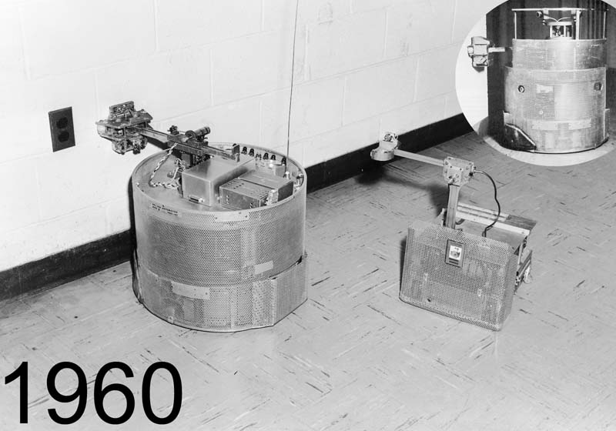
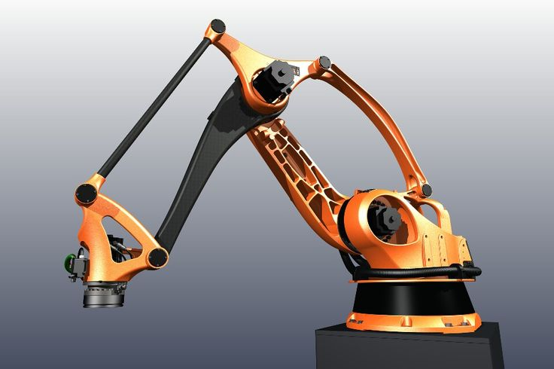
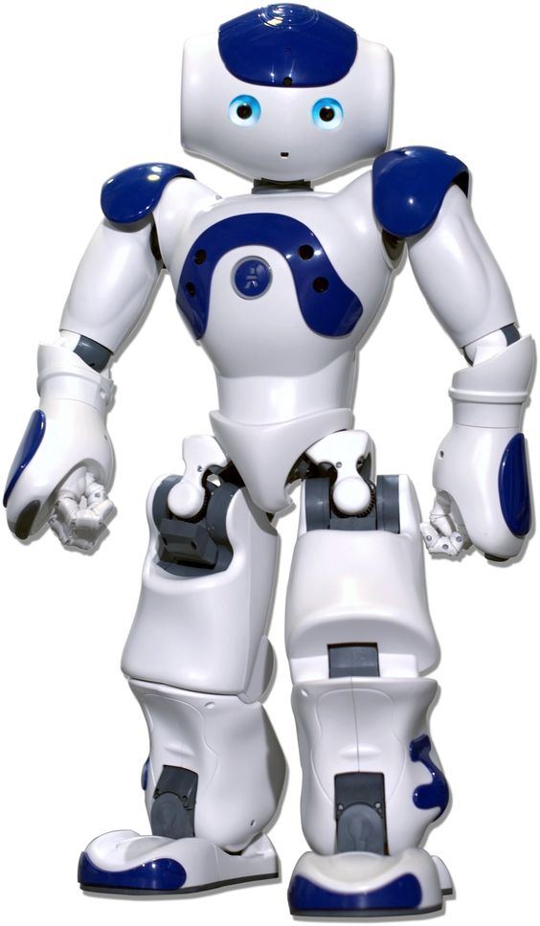

Why Computer Science?
1945 1960 2000 2016

Slide 4
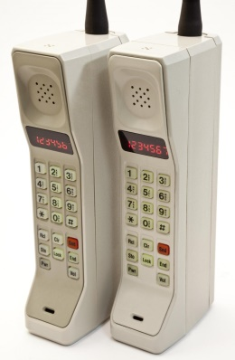
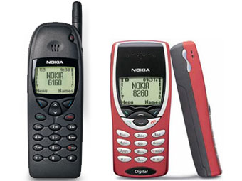



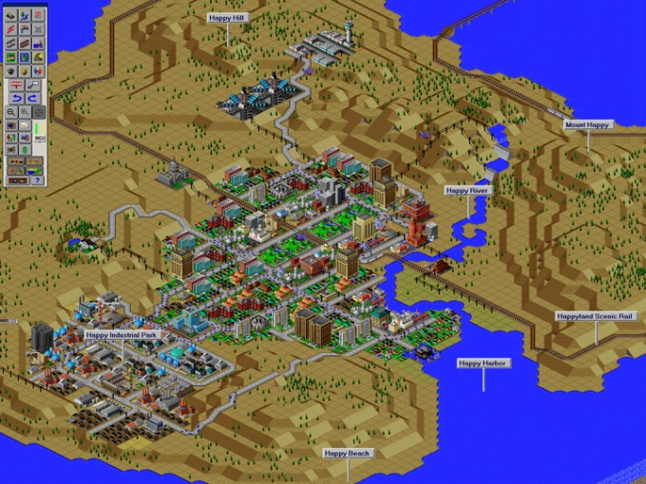

Why Computer Science?
1945 1960 2000 2016

Slide 5

Where are we going past 2021?

Slide 6

Where are we going past 2021?

Slide 7
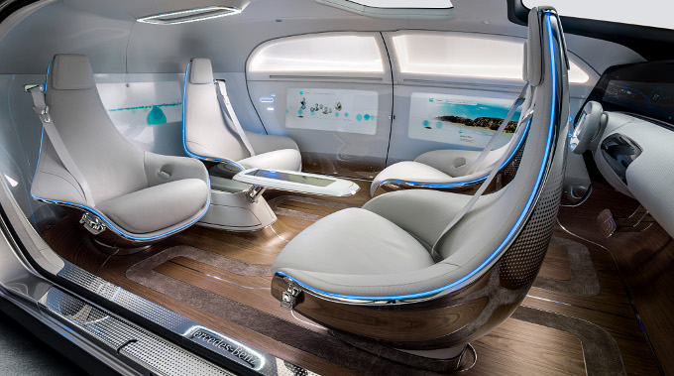
Where are we going past 2021?

Slide 8
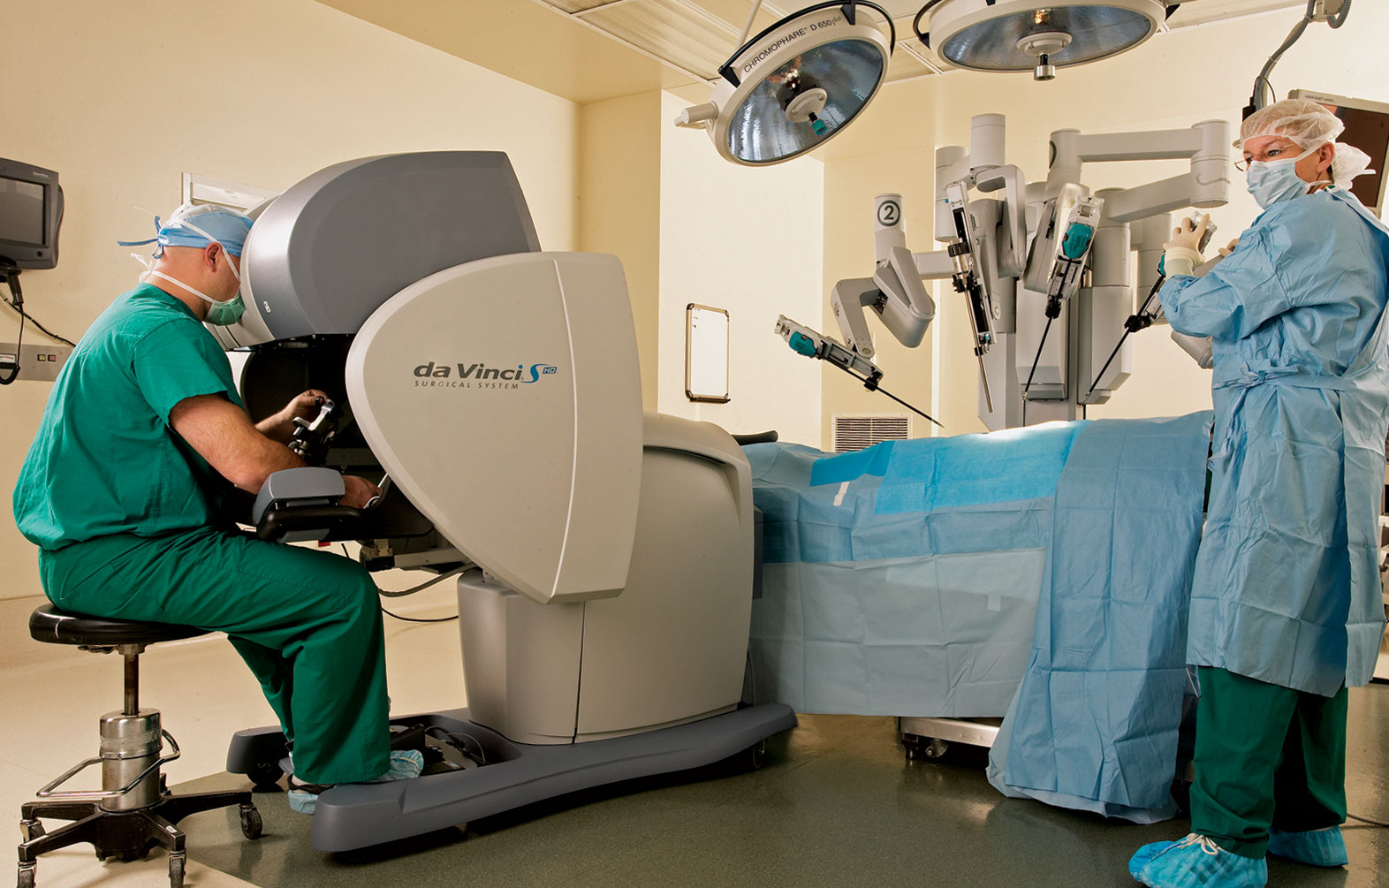
Where are we going past 2021?

Slide 9
The course
The course is made up of two exams at the end of the course.
Each exam is worth 50%
You will also complete a project looking at coding a solution to a brief.

Slide 10
Computer Science
Career for everyone
Create your own future and ideas
Create a future for other people
Give your self great problem solving skills
Give yourself a great career
Challenge yourself to be the best
Challenge yourself to change the world
Average salary for Computing jobs £47,500

